Slide 1
Loading Balance Problem
Zhiyuan Wang
12032878
Sorted greedy loading balance strategy

Slide 2
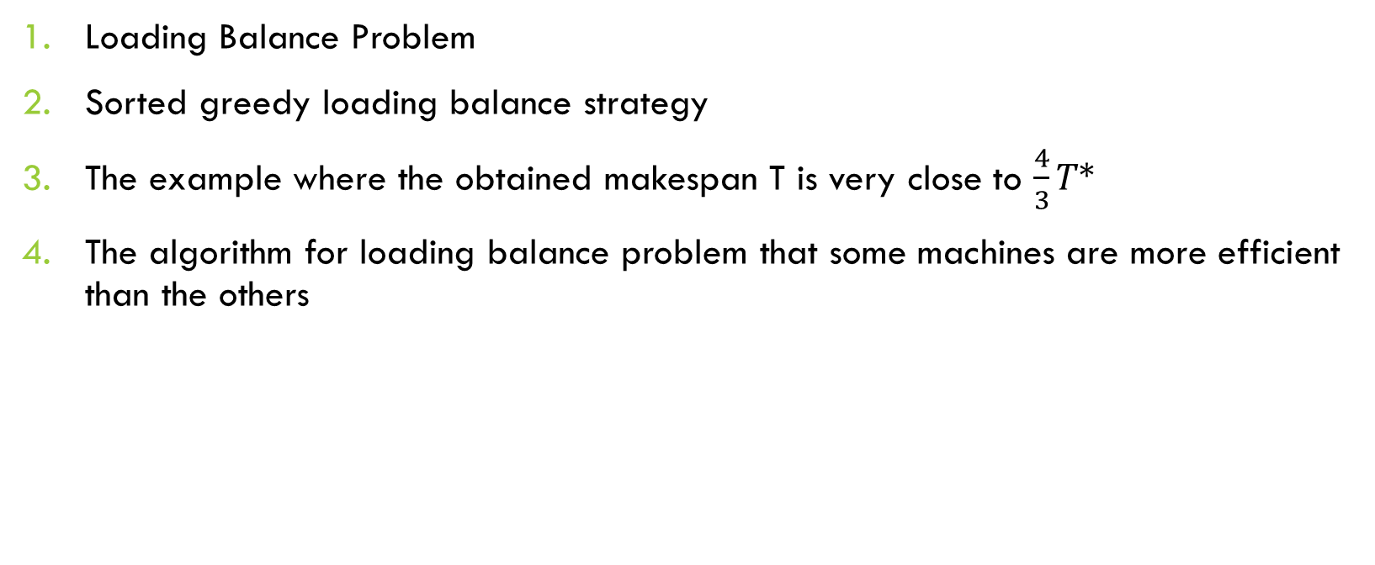
Content
Loading Balance Problem
Sorted greedy loading balance strategy
The example where the obtained makespan T is very close to $\frac{4}{3}T∗$
The algorithm for loading balance problem that some machines are more efficient than the others

Slide 3
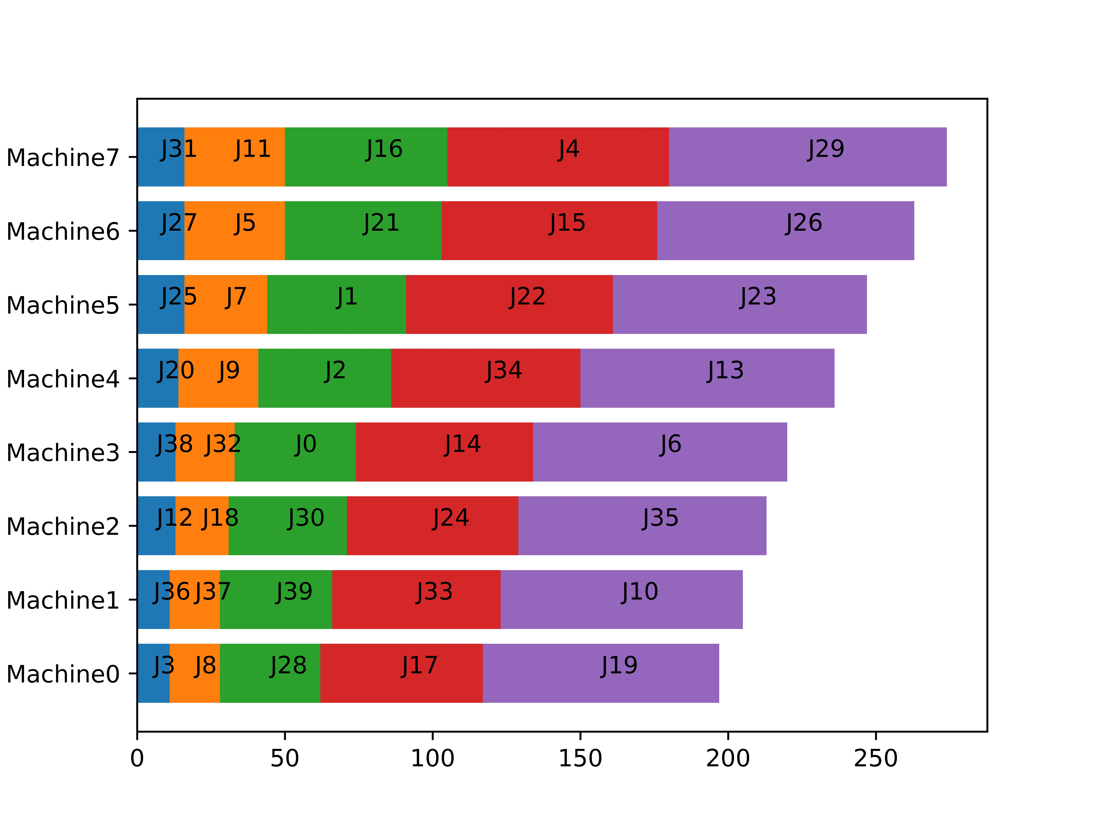
Loading Balance Problem
This problem’s target is assign jobs to computing machines to minimizes the total time consumption.

Slide 4
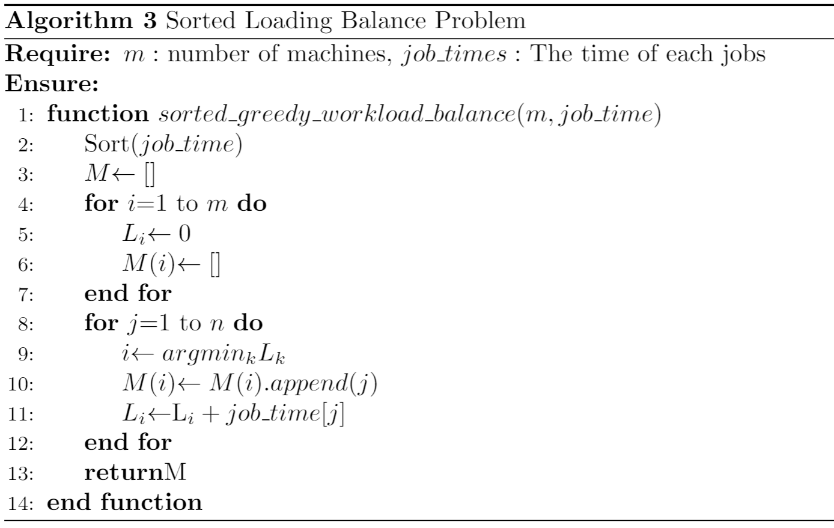
Sorted greedy loading balance strategy
This strategy will assign the longest job to the machine with the smallest load in an arbitrary order of jobs.

Slide 5


Effect of algorithm
If the theoretical optimal makespan of the job queue is T*, then the sorted greedy algorithm’s makespan T will not worse than $\frac{4}{3}T∗$.
$$T^{∗}≤T≤\frac{4}{3}T^{∗}$$

Slide 6
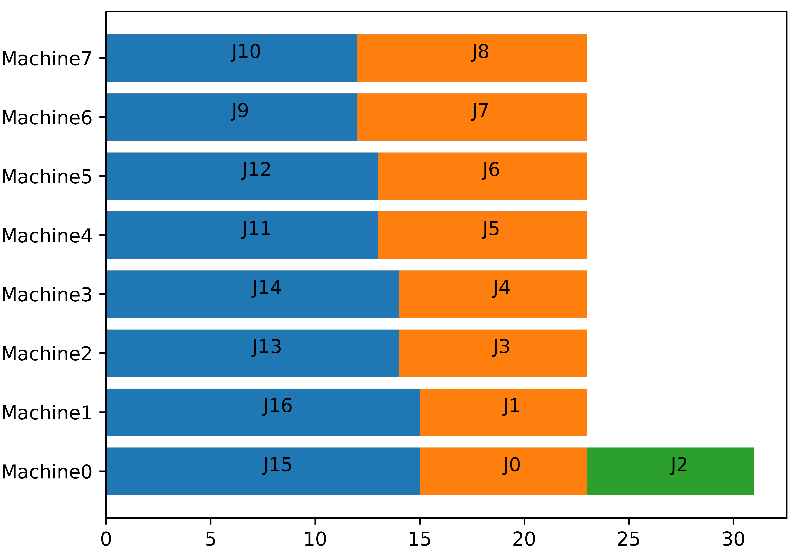
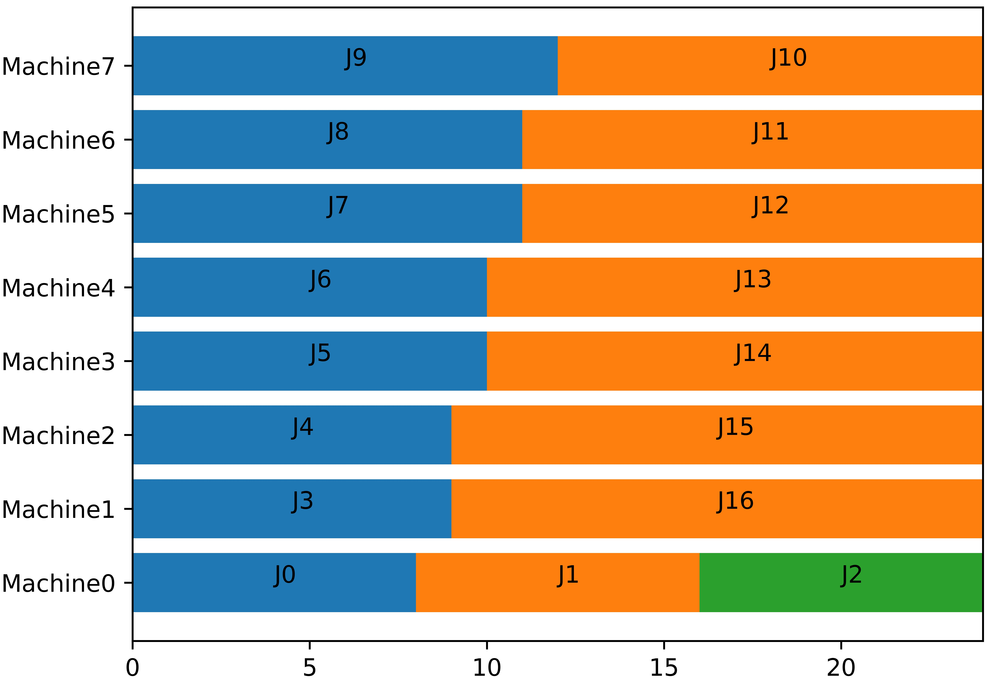
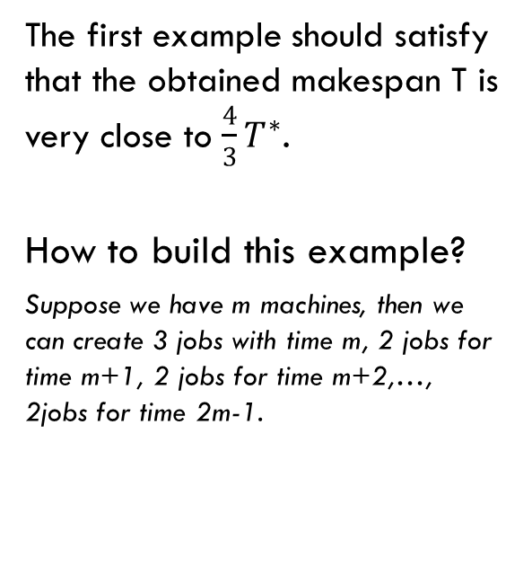
The first Example
Result of sorted greedy algorithm
The first example should satisfy that the obtained makespan T is very close to $\frac{4}{3}T^{∗}$.
How to build this example?
Suppose we have m machines, then we can create 3 jobs with time m, 2 jobs for time m+1, 2 jobs for time m+2,…, 2jobs for time 2m-1.
Optimal result

Slide 7
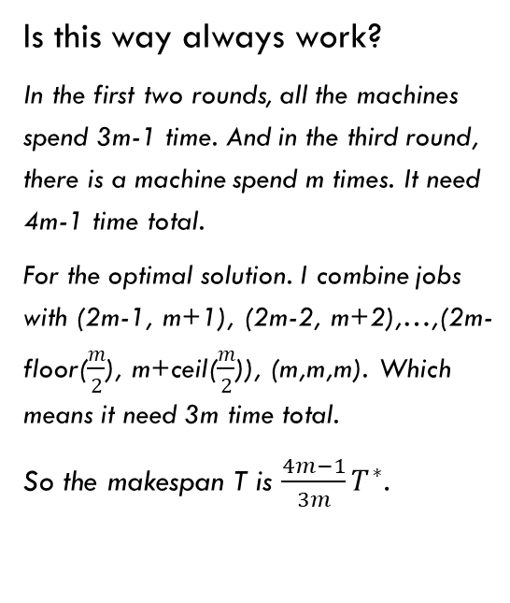
The first Example
Result of sorted greedy algorithm
Is this way always work?
In the first two rounds, all the machines spend 3m-1 time. And in the third round, there is a machine spend m times. It need 4m-1 time total.
For the optimal solution. I combine jobs with (2m-1, m+1), (2m-2, m+2),…,(2m-floor($\frac{m}{2}$), m+ceil($\frac{m}{2}$)), (m,m,m). Which means it need 3m time total.
So the makespan T is $\frac{4m−1}{3m}T^{∗}$.
Optimal result

Slide 8
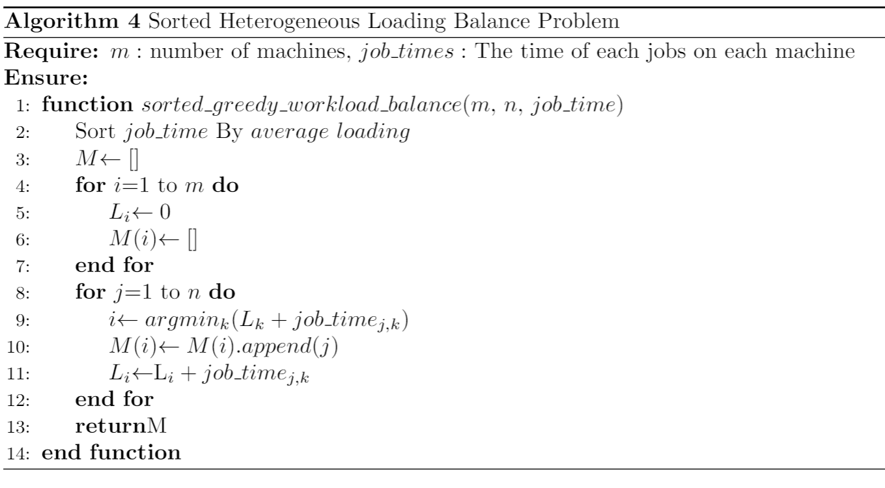
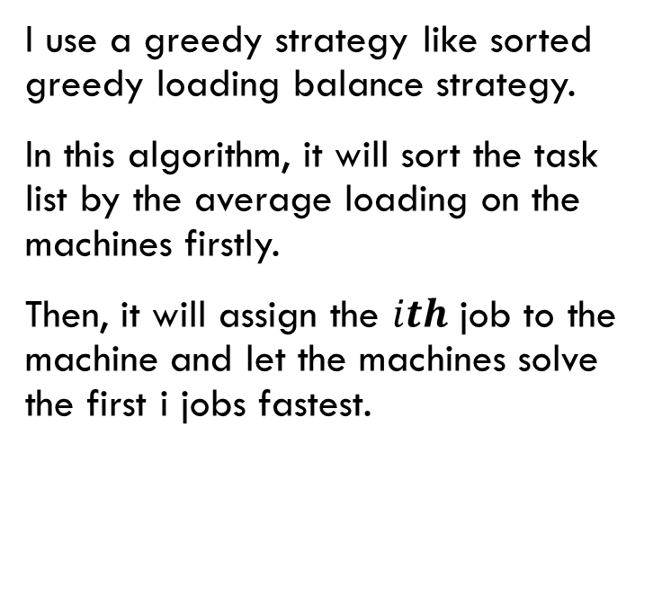
Algorithm for the case that Some machines are more efficient than the others
I use a greedy strategy like sorted greedy loading balance strategy.
In this algorithm, it will sort the task list by the average loading on the machines firstly.
Then, it will assign the $ith$ job to the machine and let the machines solve the first i jobs fastest.

Slide 9
Algorithm for the case that Some machines are more efficient than the others
Experiment to verify the quality of the algorithm.
For the jobs, I generate the base cost for each job, and then I generate a factor between 0.5 to 1.5 to each job on each machine.
Generate 1000 cases respectively for 3 machines with 7 jobs, 3 machines with 8 jobs, 4 machines with 9 jobs and 5 machines with 11 jobs.
Give some examples
Do statistic for the quality of the cases
Job Machine | J1 | J2 | J3
Base | 2 | 3 | 4
M1 | 1 | 2.34 | 3.2
M2 | 1.81 | 3.12 | 4.21
m3 | 3 | 4.11 | 5.64

Slide 10
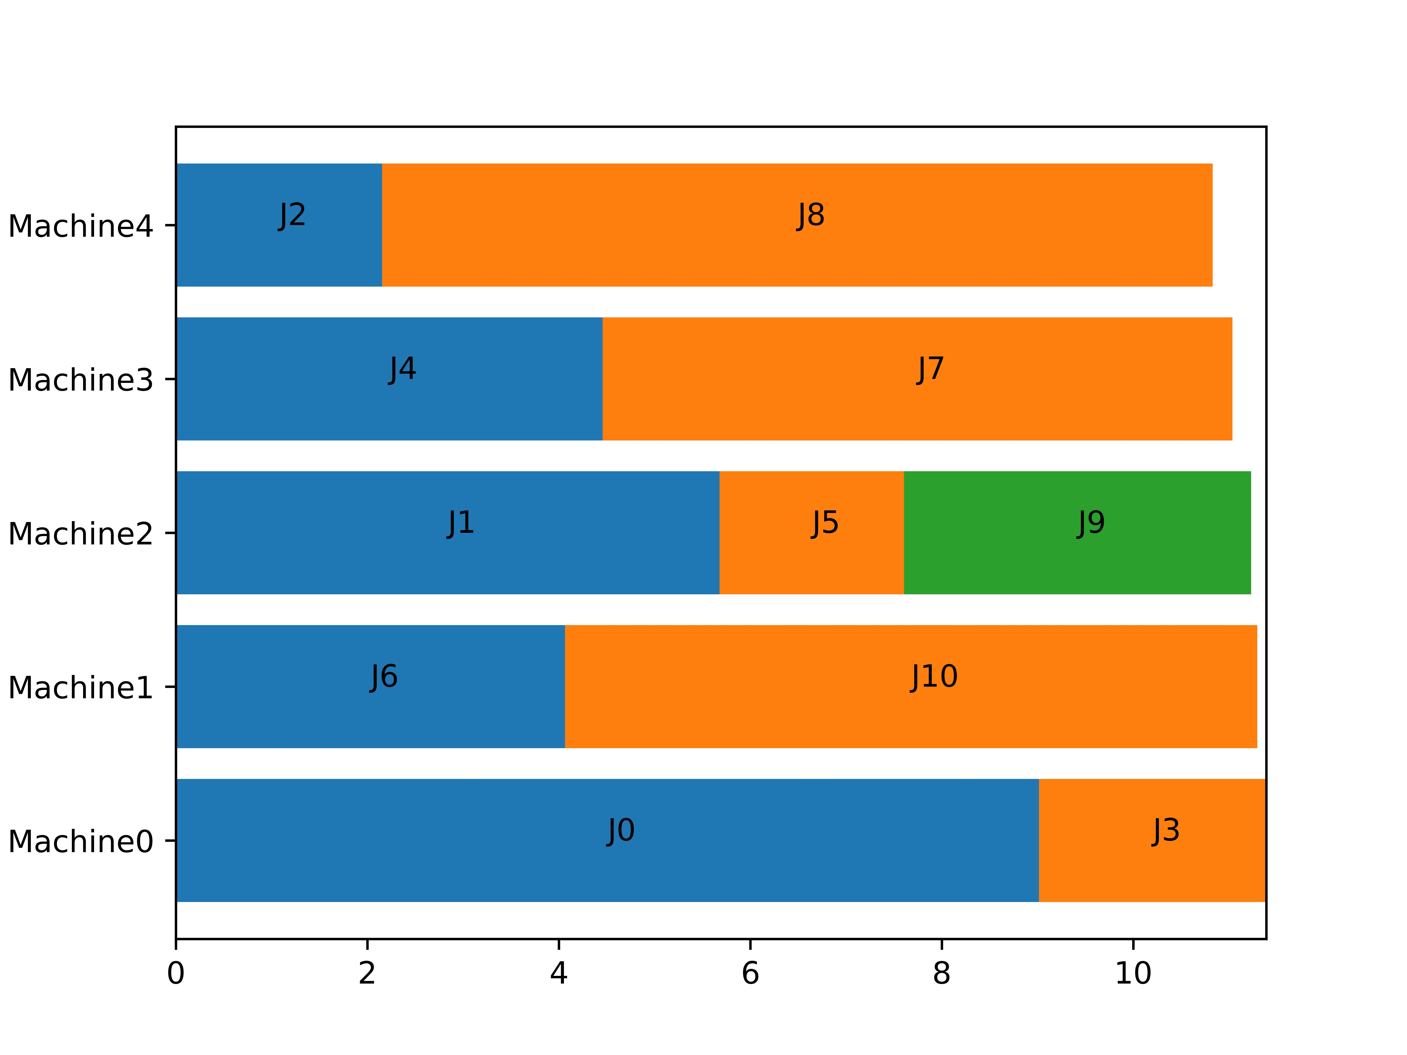
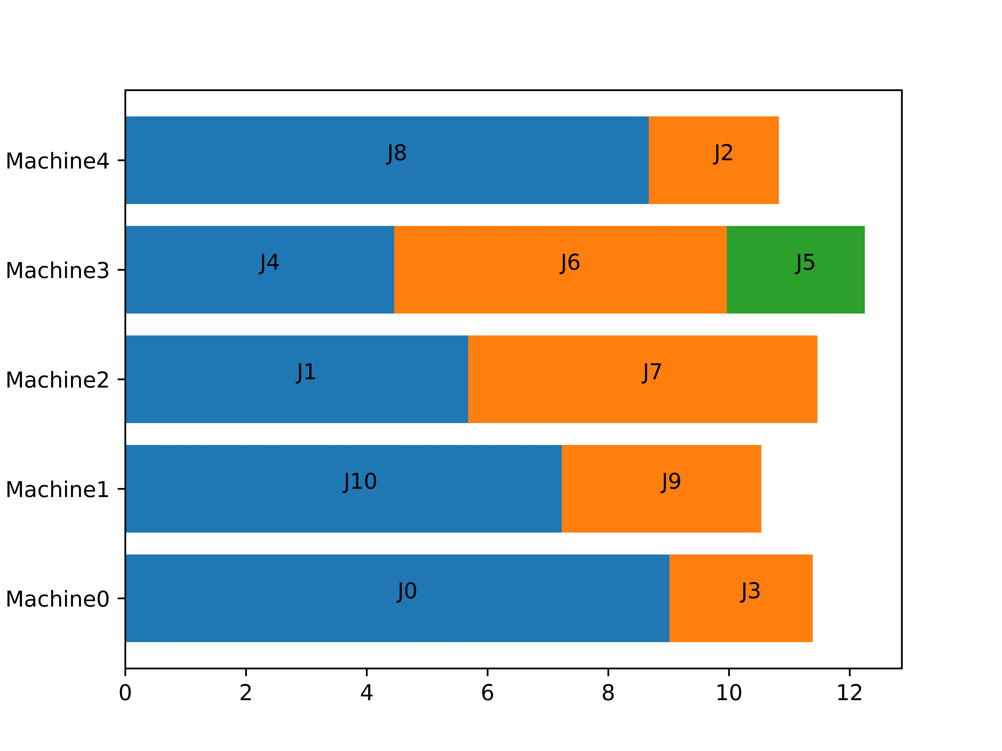
Algorithm for the case that Some machines are more efficient than the others
Optimal Solution
Greedy Solution

Slide 11
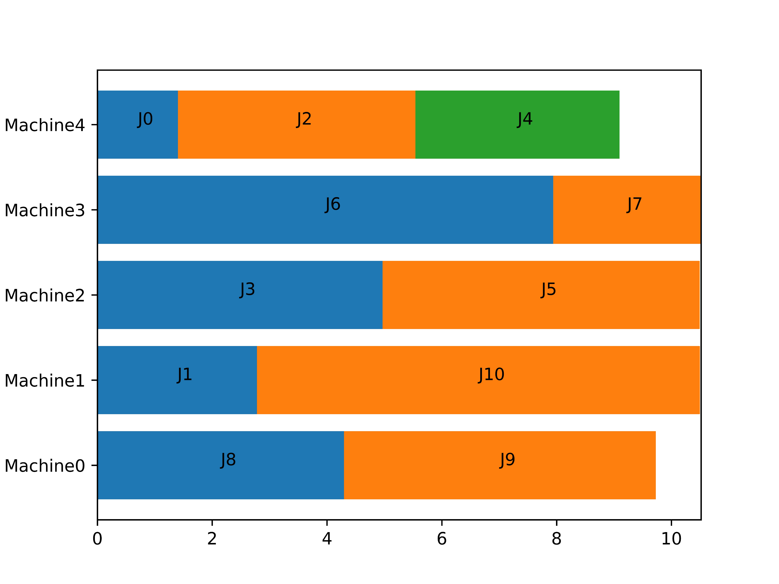
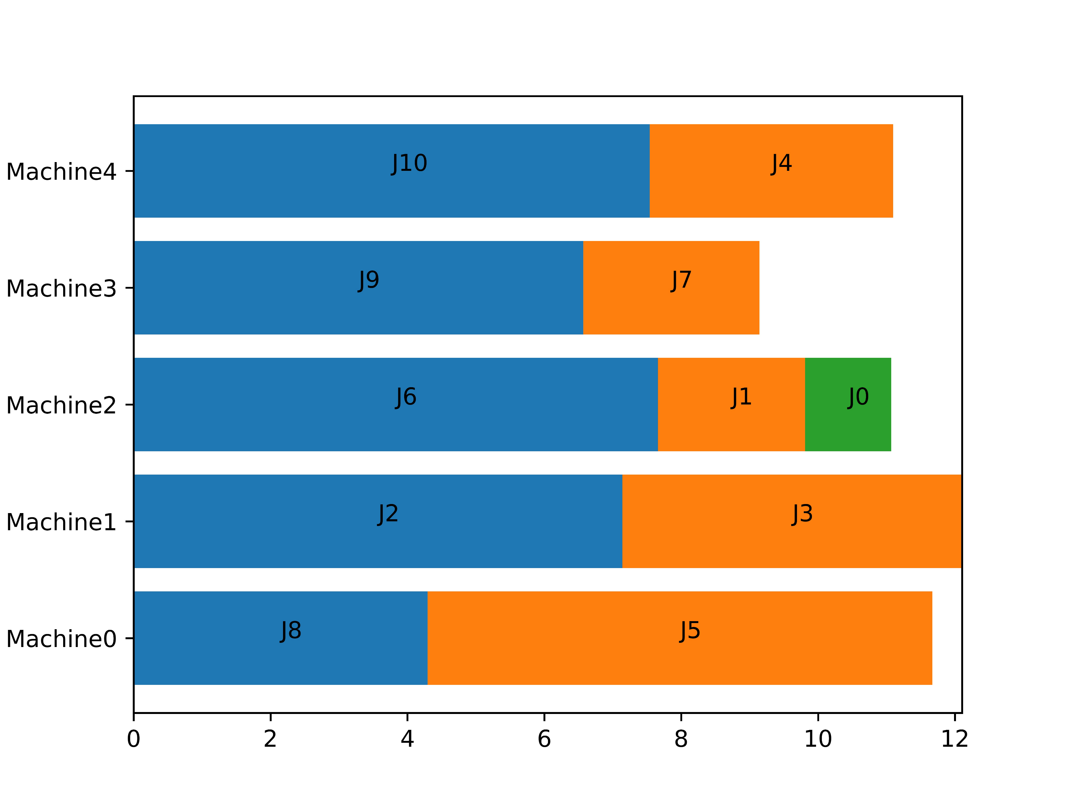
Algorithm for the case that Some machines are more efficient than the others
Optimal Solution
Greedy Solution

Slide 12
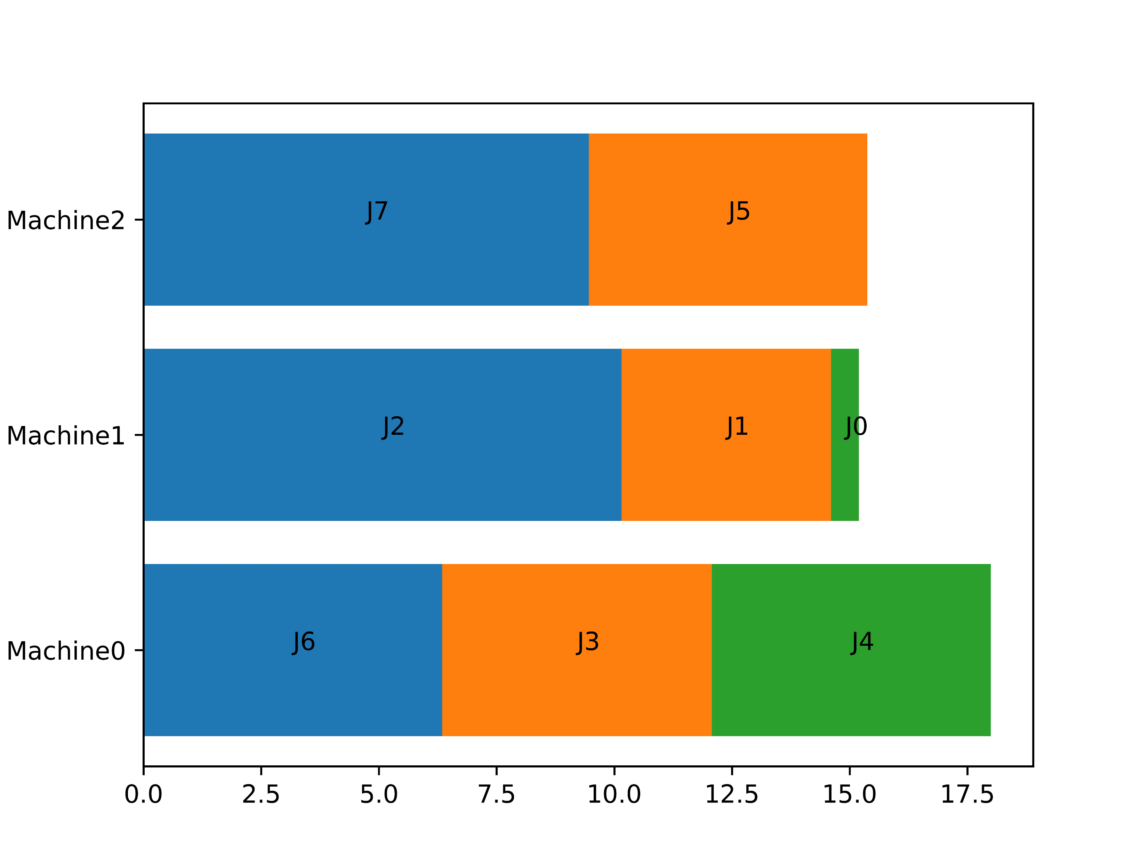
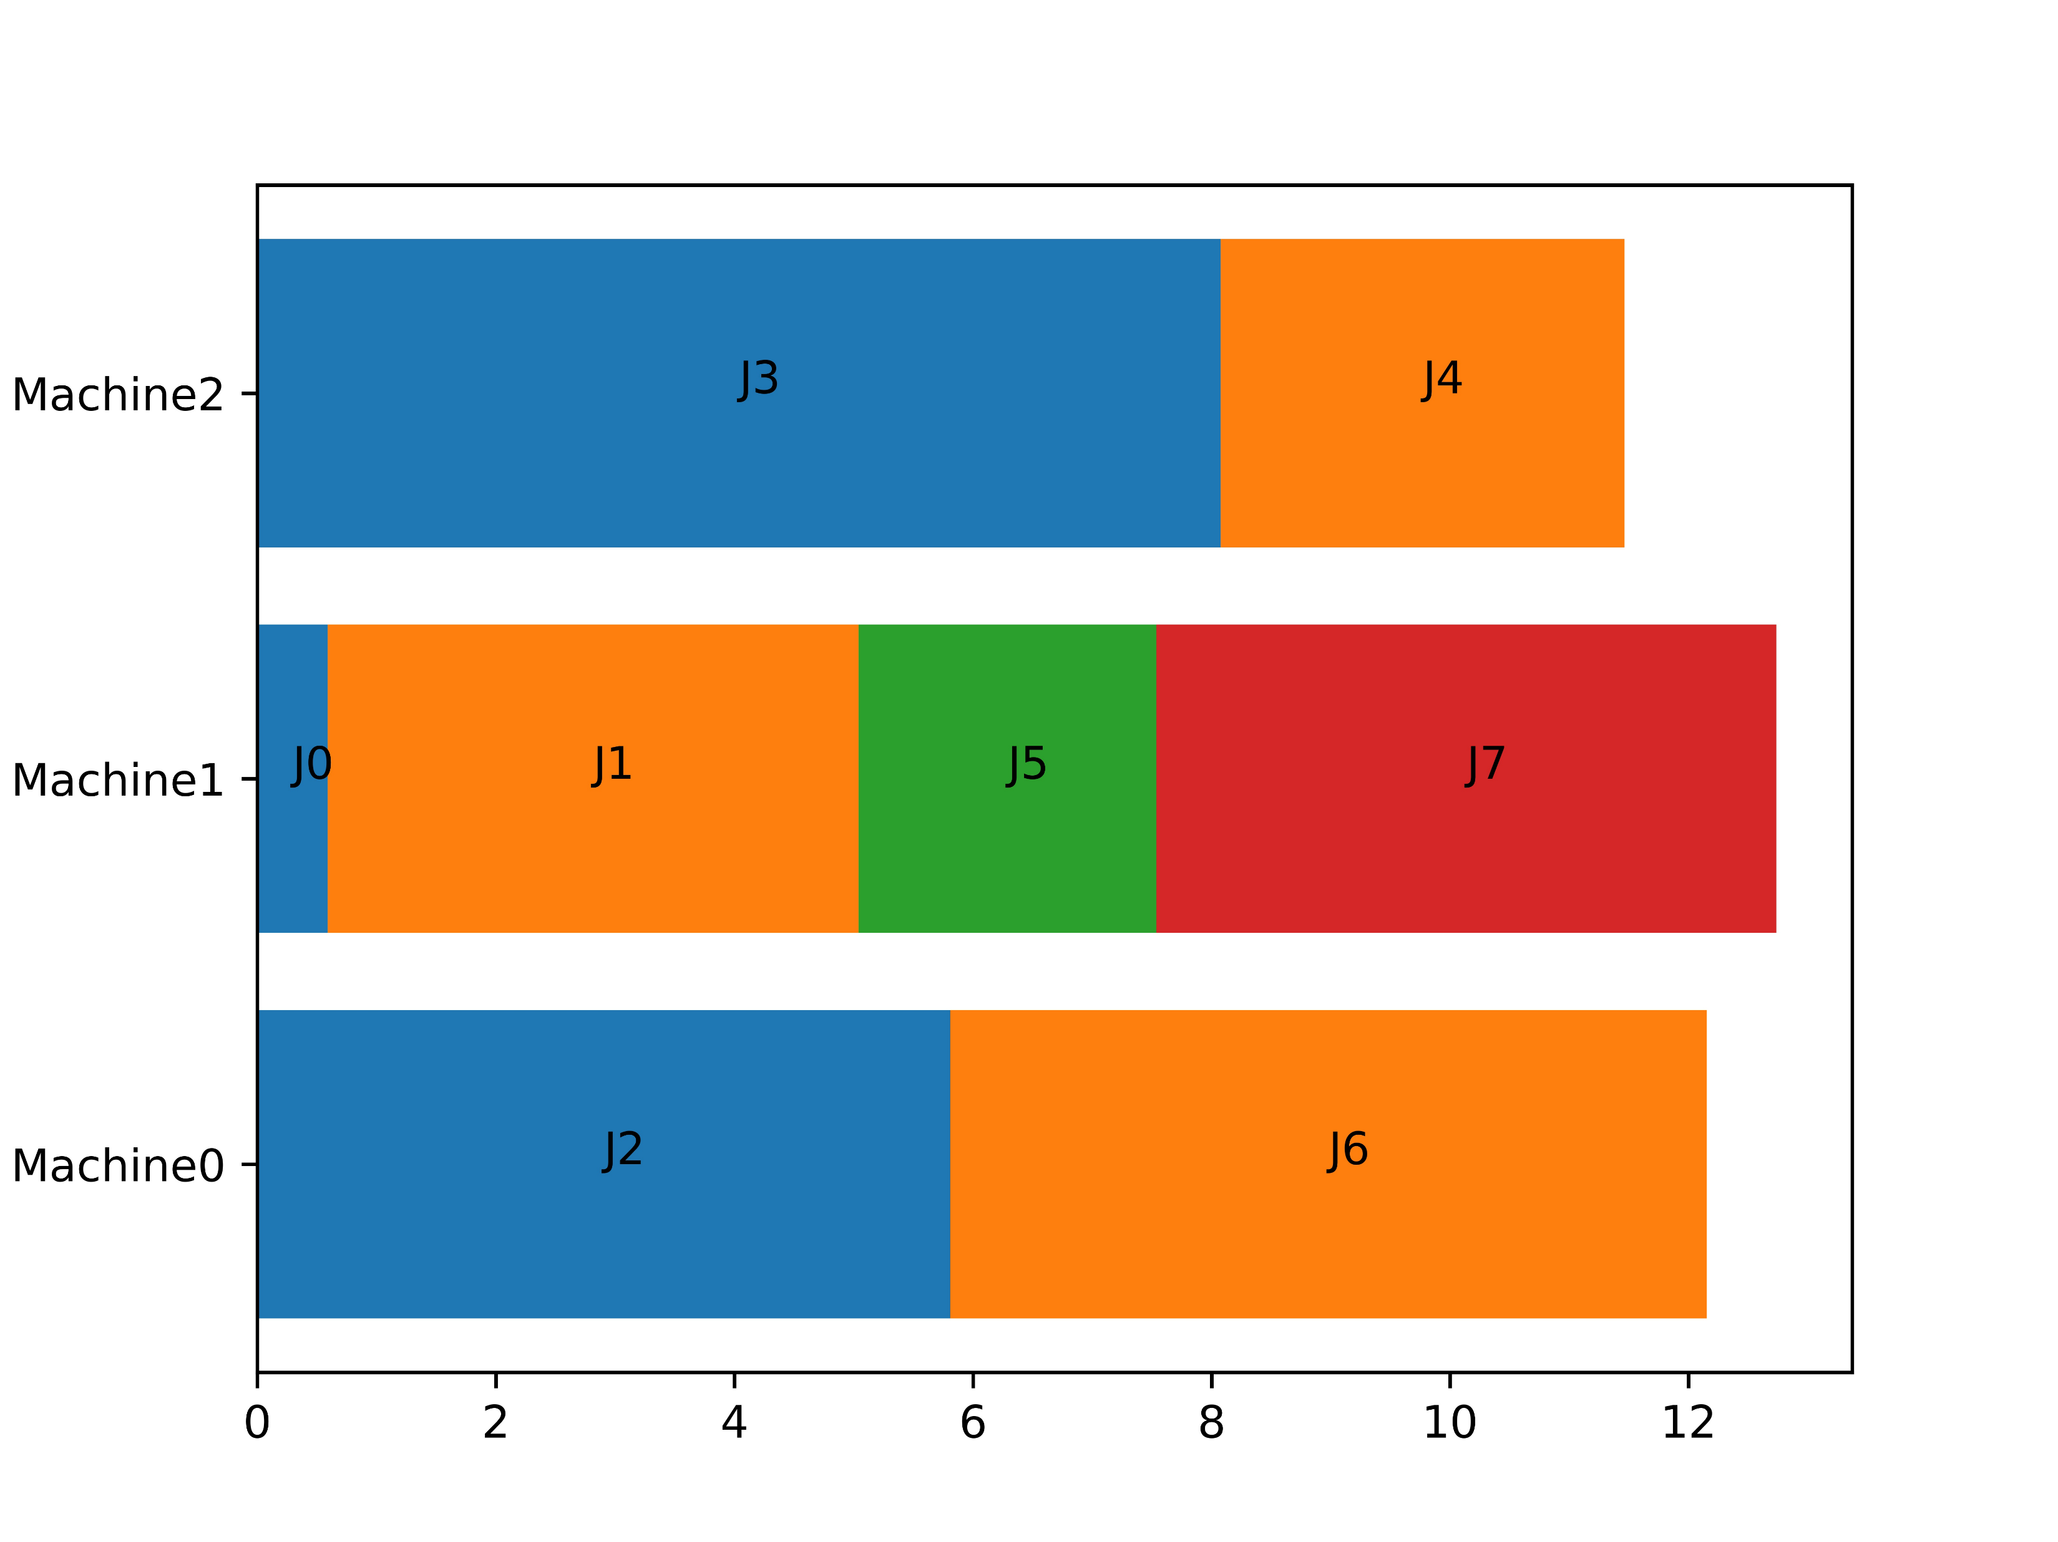
Algorithm for the case that Some machines are more efficient than the others
Greedy Solution
Job Machine | J0 | J1 | J2 | J3 | J4 | J5 | J6 | J7
M1 | 1.19 | 7.42 | 5.81 | 5.72 | 5.93 | 5.83 | 6.34 | 10.80
M2 | 0.59 | 4.45 | 10.15 | 10.26 | 4.46 | 2.50 | 8.60 | 5.20
m3 | 1.35 | 11.07 | 11.89 | 8.08 | 3.38 | 5.92 | 13.34 | 9.46
Quality is 1.4133
Optimal Solution

Slide 13
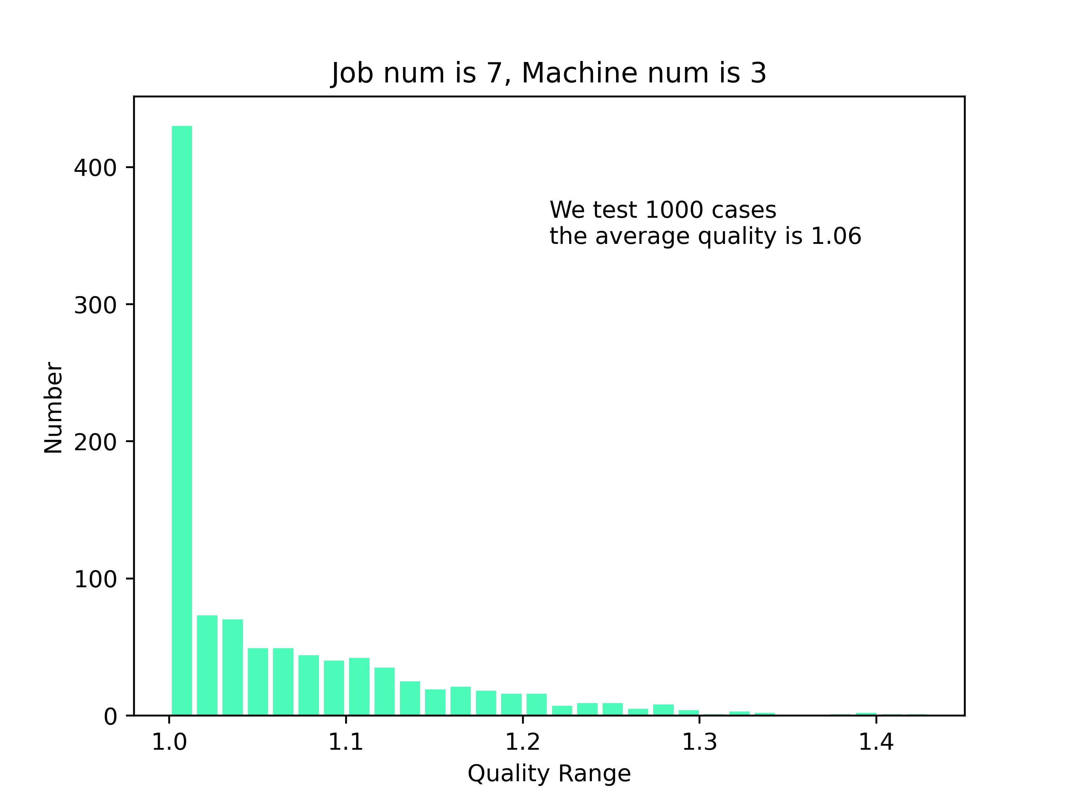
Algorithm for the case that Some machines are more efficient than the others

Slide 14
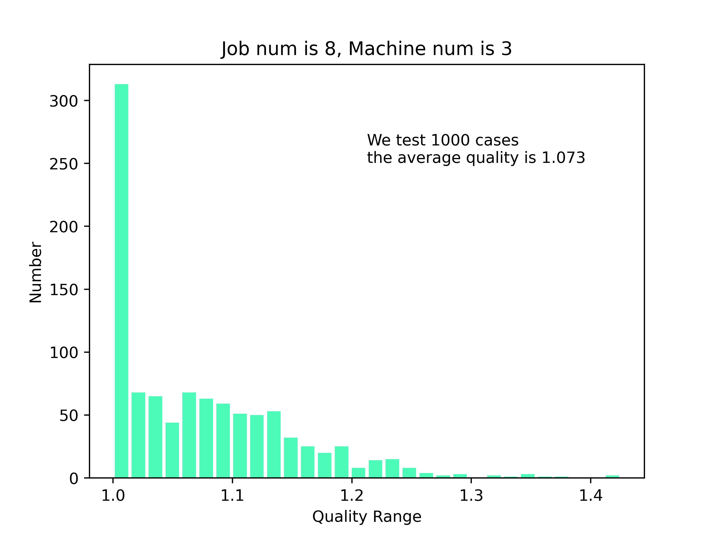
Algorithm for the case that Some machines are more efficient than the others

Slide 15
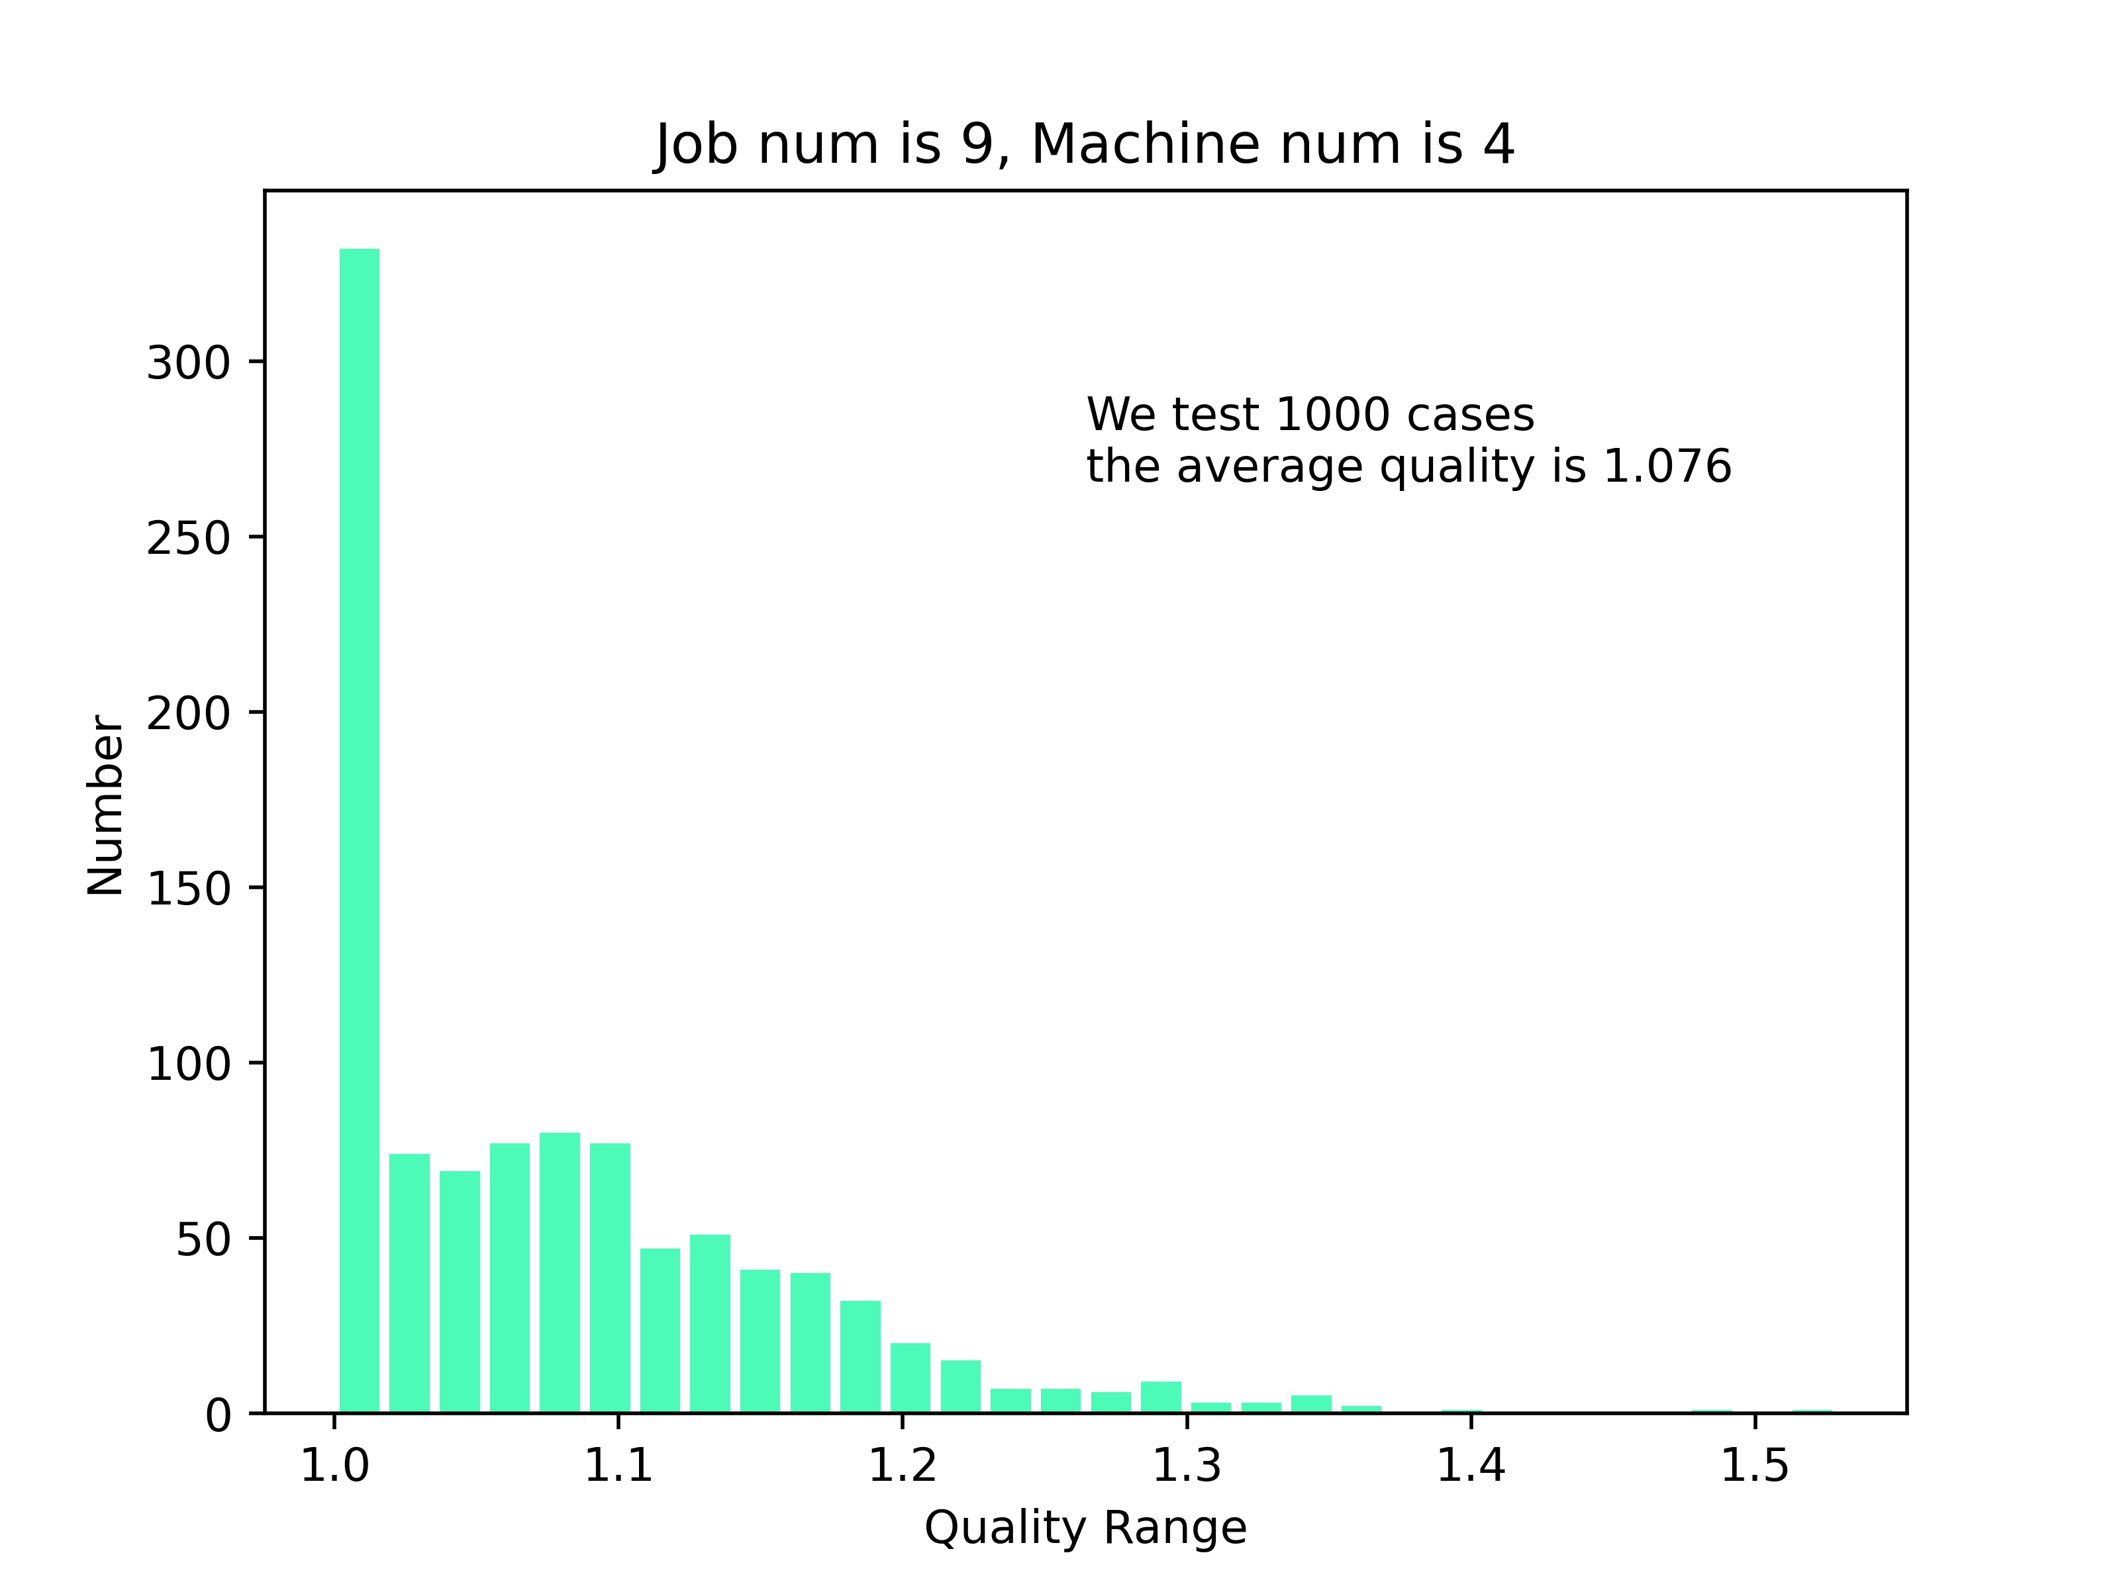
Algorithm for the case that Some machines are more efficient than the others

Slide 16
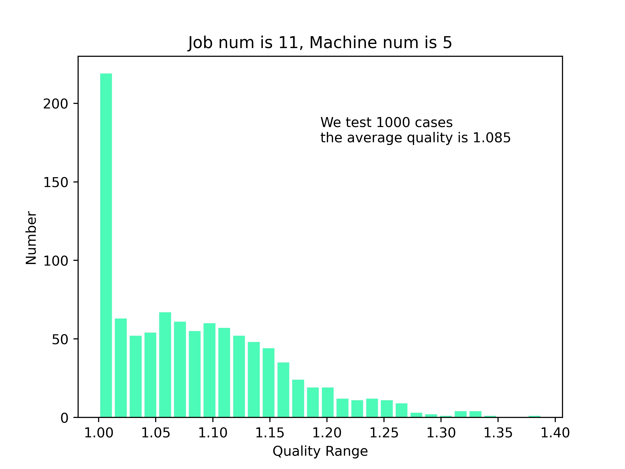
Algorithm for the case that Some machines are more efficient than the others

Slide 17
Thank You !
Q&A

